Slide 1
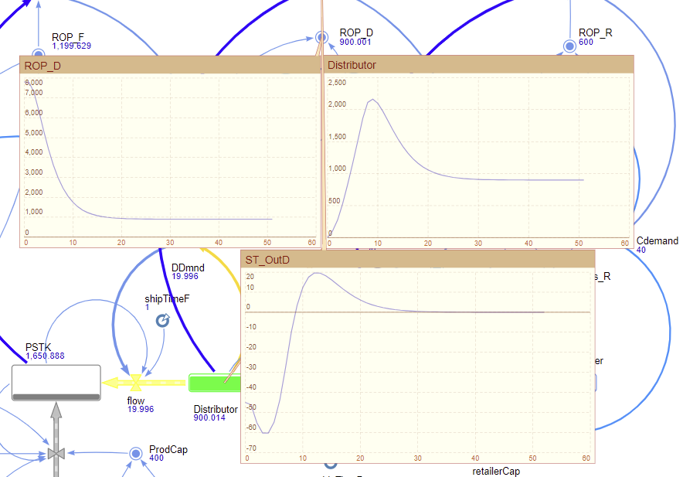

Slide 2
Table: Stockout Days analysis based on Demand variation
Echelon | Scenario | Demand Level | Stockout Time (days)
Factory | Baseline | Cdemand = 55 | 12 days
 | Lower Demand | Cdemand = 40 | 10 days
Distributor | Baseline | Cdemand = 55 | 10 days
 | Lower Demand | Cdemand = 40 | 8.5 days
Retailer | Baseline | Cdemand = 55 | 6.8 days
 | Lower Demand | Cdemand = 40 | 6.5 days

Slide 3
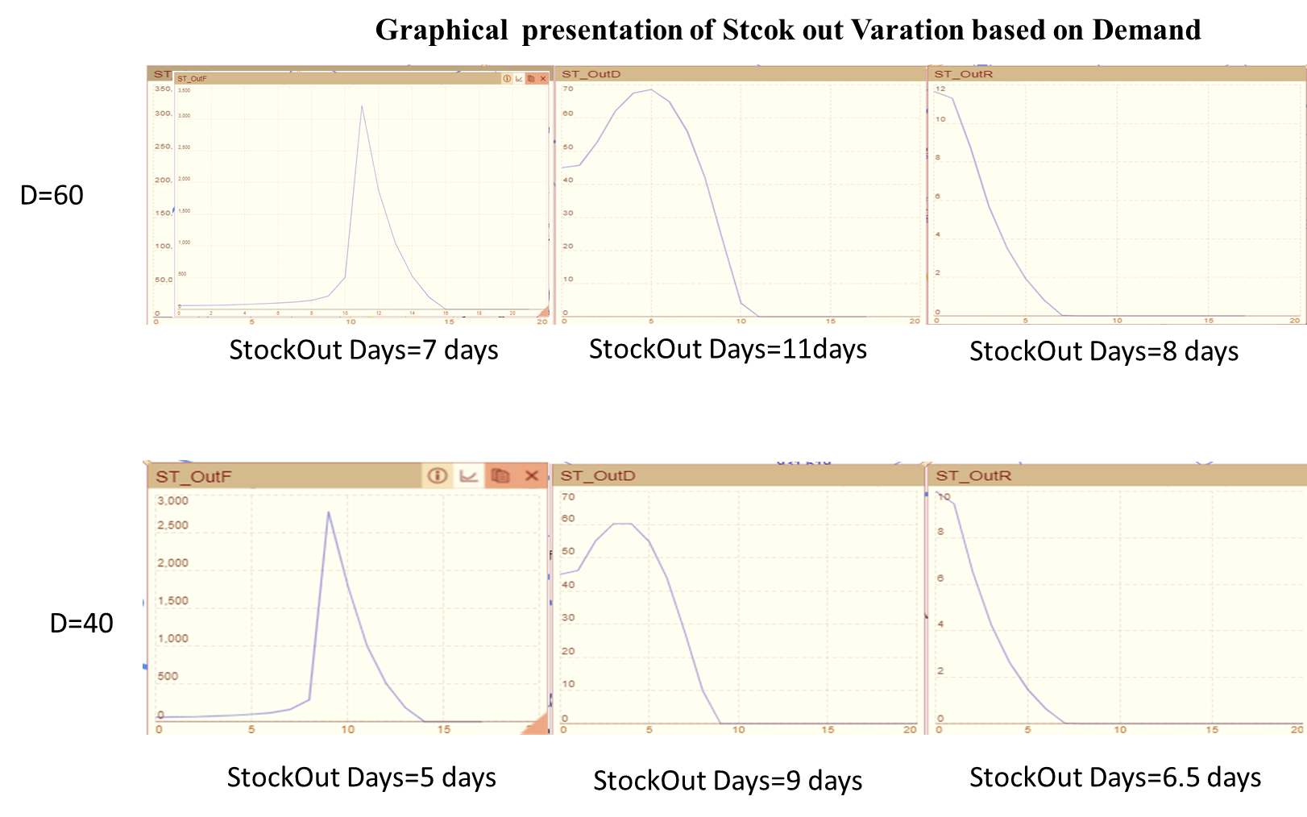

Slide 4
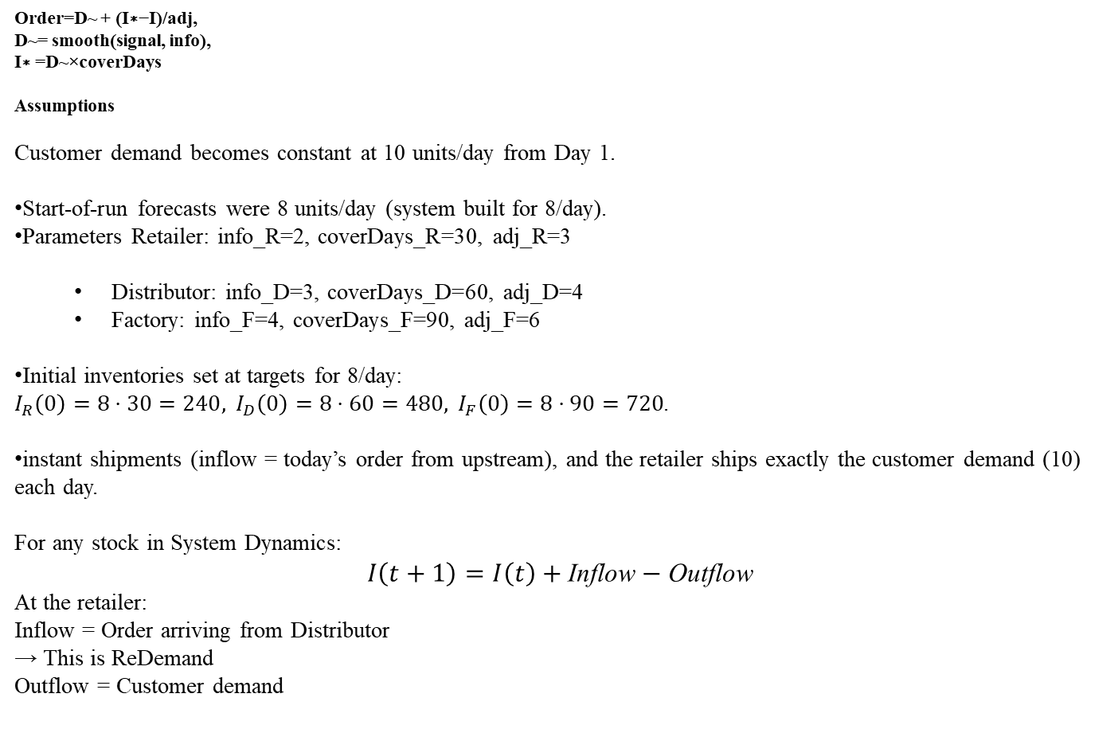
Mathematical Formulation
Order=D~ + (I∗−I)/adj​,
D~= smooth(signal, info),
I∗ =D~×coverDays
Assumptions
Customer demand becomes constant at 10 units/day from Day 1.
Start-of-run forecasts were 8 units/day (system built for 8/day).
Parameters Retailer: info_R=2, coverDays_R=30, adj_R=3
Distributor: info_D=3, coverDays_D=60, adj_D=4
Factory: info_F=4, coverDays_F=90, adj_F=6
Initial inventories set at targets for 8/day: $I_{R}\left(0\right)=8⋅30=240, I_{D}\left(0\right)=8⋅60=480, I_{F}\left(0\right)=8⋅90=720$.
instant shipments (inflow = today’s order from upstream), and the retailer ships exactly the customer demand (10) each day.
For any stock in System Dynamics:
$$I\left(t+1\right)=I\left(t\right)+\text{Inflow}−\text{Outflow}$$
At the retailer:
Inflow = Order arriving from Distributor → This is ReDemand
Outflow = Customer demand

Slide 5
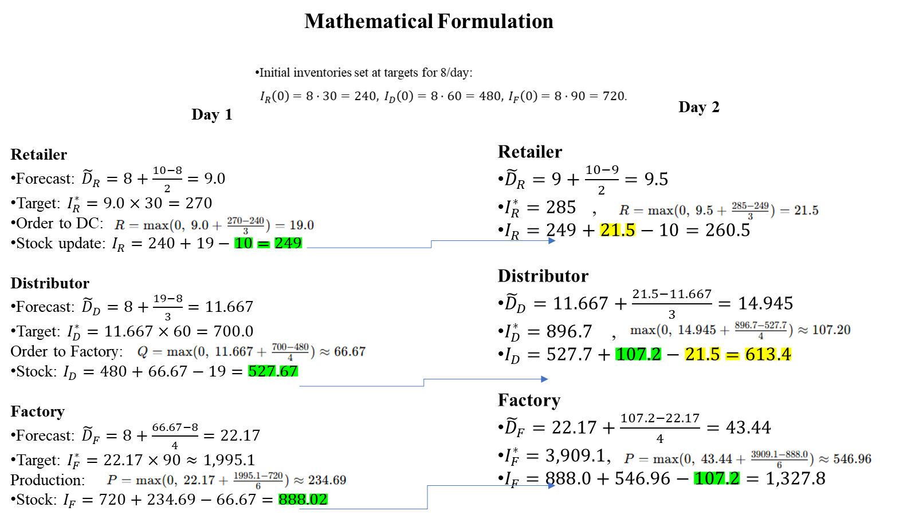
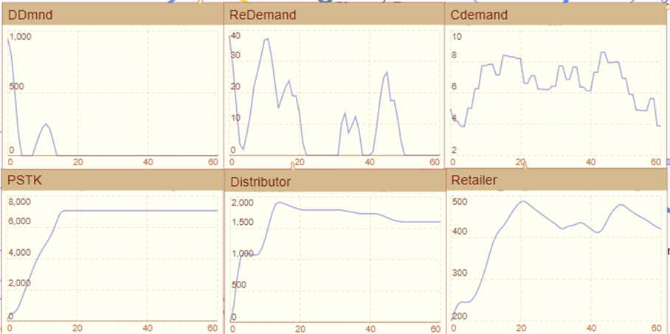
Working Principle of the Designed SD Model
Ini Demand
Forecasted Demand
30*9.5
Demand to Dist
60*14.945
$I_{R}\left(t\right), I_{D}\left(t\right), I_{F}\left(t\right)$ = retailer, distributor, factory inventory.

Slide 6
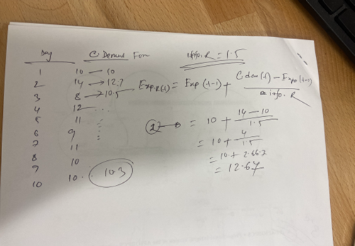
Why Demand (Orders) Flatten Over Time at Retailer & Distributor
In the initial phase of the simulation, the retailer, distributor, and factory actively adjust their inventories in response to changing customer demand. The retailer is the first point of demand observation, and any deviation from its desired stock level generates corrective orders toward the distributor.
As the simulation progresses, customer demand stabilizes around an average level, and the exponential smoothing used for demand forecasting gradually filters out noise. As a result, expected demand values at all echelons converge to the same steady state. At this stage, the actual inventory levels approach their corresponding desired inventories, making the correction term—defined as (desired inventory minus actual inventory) divided by adjustment time—approach zero. With no remaining imbalance to correct, replenishment orders become equal to the mean customer demand.
Therefore, production inflow matches consumption outflow, and upstream inventories no longer accumulate or deplete, resulting in long, flat plateaus in the distributor and factory stock curves. This behavior confirms that the system has reached operational equilibrium.
Stage | What happens
Early (days 1–3) | Big demand fluctuations → forecast still adjusting
Mid (days 4–6) | Variation reduced → forecast settles near the mean
Late (days 7–10) | Steady forecast ≈ 10 units/day

Slide 7
ST_OutD
0 -45
1 -46.221
2 -55.15
3 -60.304
4 -60.308
5 -54.857
6 -43.852
7 -27.575
8 -9.95
9 3.422
10 12.41
11 17.524
12 19.603
13 19.557
14 18.194
15 16.144
ST_OutD
0 -45
1 -45.792
2 -53.756
3 -62.297
4 -66.668
5 -66.466
6 -61.249
7 -50.716
8 -34.892
9 -15.15
10 1.242
11 12.683
12 19.557
13 22.706
14 23.146
15 21.838
STF_D
0 5
1 4.226
2 -2.721
3 -6.237
4 -4.209
5 1.756
6 9.899
7 19.804
8 30.651
9 40.438
10 47.916
11 52.949
12 55.718
13 56.946
RStockOut
0 0.5
1 0.995
2 3.374
3 5.331
4 6.598
5 7.51
6 8.152
7 8.63
8 8.964
9 9.29
10 9.593
11 9.738
12 9.85
13 9.928

Slide 9
RESEARCH PROGRESS
Reported by
Student’s name: S M Atikur Rahman
Date: 11/20/2025

Slide 10

Echelon
Echelon

Slide 11
Introduction
Demand variability typically originates at the customer level but becomes increasingly amplified as orders propagate upstream across a supply chain, resulting in the well-known bullwhip effect.
This study develops a system dynamics simulation model of a four-echelon network comprising customer, retailer, distributor, and factory implemented in AnyLogic to investigate the operational drivers of this amplification and its impact on supply chain resilience.
The model incorporates stochastic customer demand, exponential smoothing based forecasting, inventory cover policies, proportional correction rules, and physical shipment constraints. Simulation results show that variation in Demand and inventory adjustment, combined with higher safety-stock targets and longer release times upstream, lead to significant variance growth in production and inventory at the factory level.
The proposed model provides a dynamic testbed for diagnosing bullwhip mechanisms and evaluating alternative policies that improve responsiveness and resilience in multi-echelon supply chains.

Slide 12
Problem Description
Supply chains with multiple echelons are highly vulnerable to the bullwhip effect, where small fluctuations in customer demand propagate upstream and become amplified as orders and inventories swing excessively.
These oscillations lead to increased holding costs, production inefficiencies, lost sales, and reduced service levels. In real-world industries especially those characterized by long lead times, capacity constraints, and high safety stock strategies this dynamic instability becomes a critical operational challenge.
However, due to increasing lead times, larger target cover stocks, and slower response speeds toward the upstream end of the network, the factory experiences the most pronounced variability in both production and inventory levels.
This model captures how decision-making delays, shipment release limits, and demand variation interact to intensify order variability and destabilize material planning.

Slide 13
Contributions/Objectives of this study
Development of a fully dynamic, feedback-driven simulation model in AnyLogic that spans customer, retailer, distributor, and factory levels.
Integrated Bullwhip Equations Linking Forecasting, Inventory Policies, and Safety-Stock Requirements.
Policy evaluation is conducted through scenario-based inventory performance analysis, enabling a comprehensive examination of how alternative inventory control strategies respond to varying demand conditions.

Slide 14
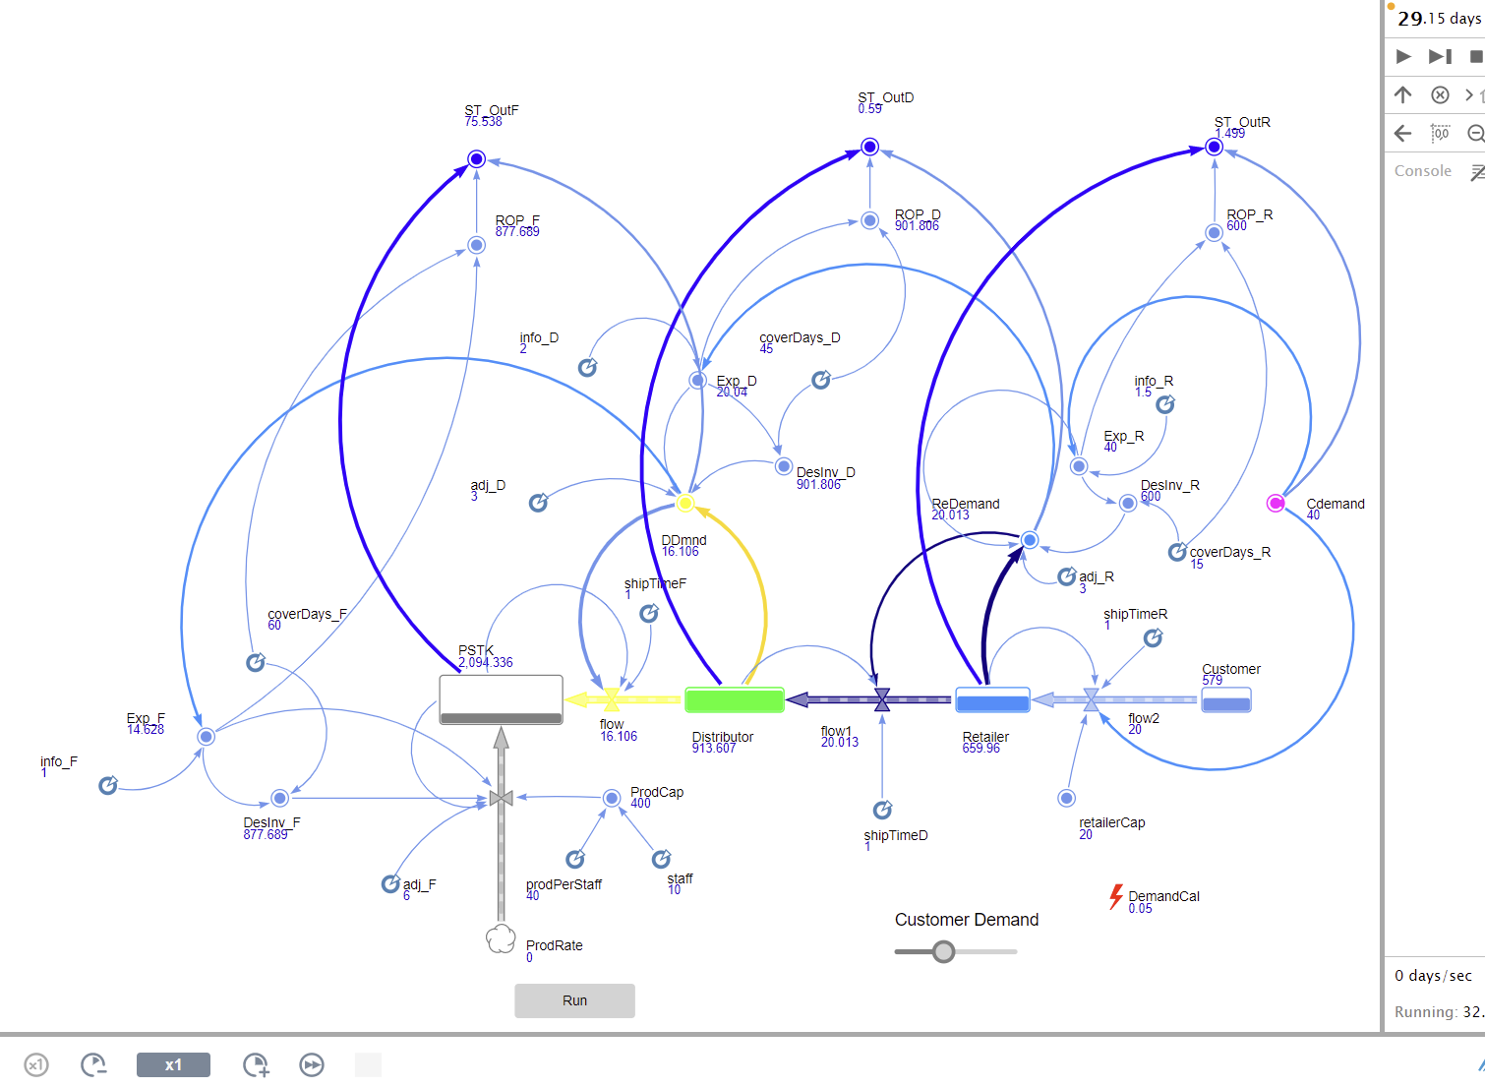
AnyLogic System Dynamics Model for Bullwhip Effect

Slide 15
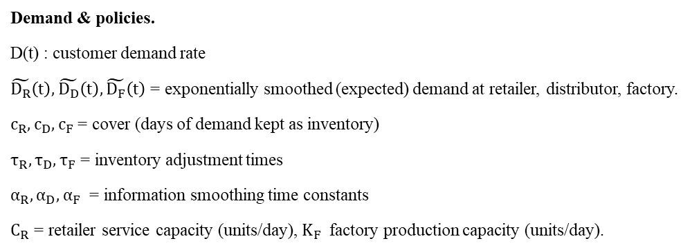
Mathematical Explanation
Demand & policies.
D(t) : customer demand rate
$\tilde{D_{R}}\left(t\right),\tilde{D_{D}}\left(t\right),\tilde{D_{F}}\left(t\right)$ = exponentially smoothed (expected) demand at retailer, distributor, factory.
$c_{R},c_{D},c_{F}$ = cover (days of demand kept as inventory)
$τ_{R},τ_{D},τ_{F}$ = inventory adjustment times
$α_{R},α_{D},α_{F}$ = information smoothing time constants
$C_{R}$ = retailer service capacity (units/day), $K_{F}$ factory production capacity (units/day).
Sterman, J. D. (1989). Modeling managerial behavior: Misperceptions of feedback in a dynamic decision making experiment. Management science, 35(3), 321-339.

Slide 16
Replenishment policy
The replenishment policy used in this study follows the standard order-up-to (OUT) formulation seen in stochastic lead-time demand inventory models, where replenishment equals forecasted demand plus a proportional safety correction based on inventory gap.
The modeled system represents a typical four-echelon distribution network consisting of a factory, distributor, retailer, and end customer. Customer demand can be stochastic and fluctuates daily
Layer
Flow Direction
What Happens Here
Variables in Model
Customer
Demand Retailer
Random demand disturbances enter
Cdemand
system
Retailer
Ship Customer; Order
Immediate demand response, small
Retailer, ReDemand,
Distributor
forecast delay
Distributor
Ship Retailer; Order
Larger safety stock, slower reaction
Distributor, DDmnd,
Factory
Factory
Produce , Distributor
Slowest adaptation + capacity limit
PSTK, ProdRate, flow

Slide 17
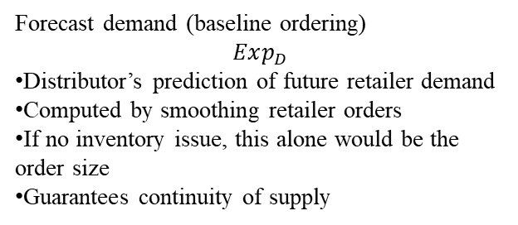
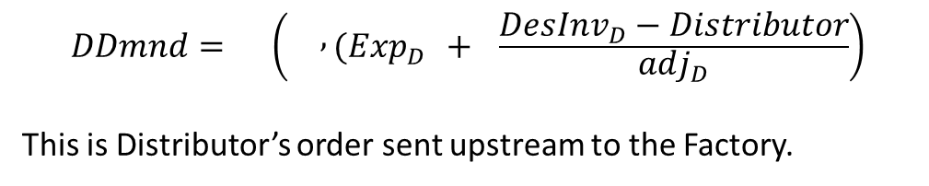
Ordering Equation
$$DDmnd=\left( , (Exp_{D} + \frac{DesInv_{D}−Distributor}{adj_{D}}\right)$$
This is Distributor’s order sent upstream to the Factory.
Inventory correction (gap adjustment)
​
This is how much inventory is missing or extra, spread over several days.
And divided by adj_D (adjustment time)
Realistic response
Prevents instant huge jumps, but still creates bullwhip when demand fluctuates
Forecast demand (baseline ordering)
$$Exp_{D}$$
Distributor’s prediction of future retailer demand
Computed by smoothing retailer orders
If no inventory issue, this alone would be the order size
Guarantees continuity of supply

Slide 18
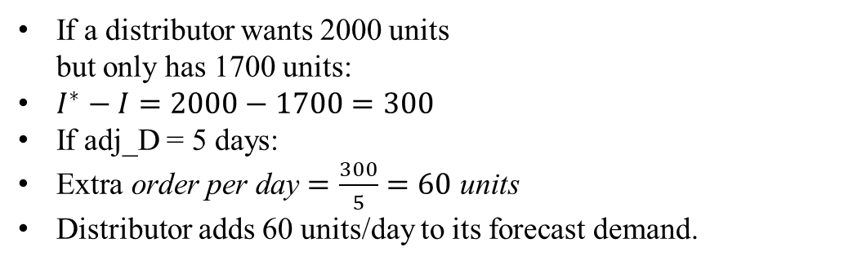
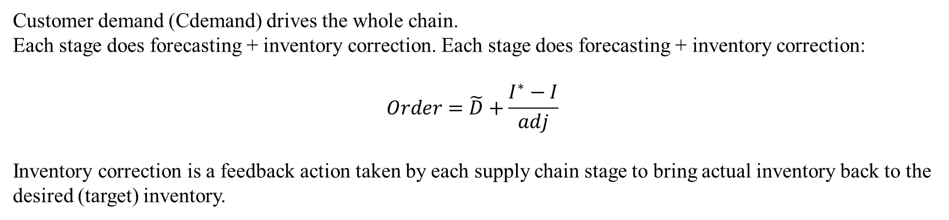
Demand Forecasting & Order Replenishment
Customer demand (Cdemand) drives the whole chain.
Each stage does forecasting + inventory correction. Each stage does forecasting + inventory correction:
$$Order=\tilde{D}+\frac{I^{∗}−I}{adj}$$
Inventory correction is a feedback action taken by each supply chain stage to bring actual inventory back to the desired (target) inventory.
If a distributor wants 2000 units but only has 1700 units:
$I^{∗}−I=2000−1700=300$
If adj_D = 5 days:
$\text{Extra} \text{order} \text{per} \text{day}=\frac{300}{5}=60 \text{units}$
Distributor adds 60 units/day to its forecast demand.

Slide 19
Dataset for Model Development
Parameter | Symbol | Value | Units | Purpose
Cover duration | coverDays_D | 45 | days | Distributor safety buffer
Smoothing time | info_D | 2.0 | days | Demand filtering delay
Adjustment time | adj_D | 4 | days | Slow correction reduces oscillation
Shipment handling time | shipTimeD | 1.0 | day | DC → Retailer shipping rate
Distributor Data
Parameter | Symbol | Value | Units | Purpose
Cover duration | coverDays_F | 60 | days | Factory safety stock target
Smoothing time | info_F | 1 | days | Slow reaction → amplification
Adjustment time | adj_F | 6 | days | Long correction delay
Shipment handling time | shipTimeF | 1.0 | day | Production release to DC
Workforce size | staff | 10 | workers | Production capacity driver
Productivity rate | prodPerStaff | 40 | units/worker/day | Total ProdCap = staff × prodPerStaff
Production Data

Slide 20
Dataset for Model Development
Parameter | Symbol | Value | Units | Purpose
Base daily demand | Cdemand0 | 40/55 | units/day | Average customer demand
Demand noise amplitude | dNoise | +-1 | units | Random variation bound
Customer Demand
Parameter | Symbol | Value | Units | Purpose
Cover duration | coverDays_R | 15 | days | Retailer safety stock policy
Smoothing time | info_R | 1.5 | days | Demand forecast delay
Adjustment time | adj_R | 3 | days | Speed of inventory correction
Shipment handling time | shipTimeR | 1 | day | Retailer → Customer release rate
Retailer Data

Slide 21
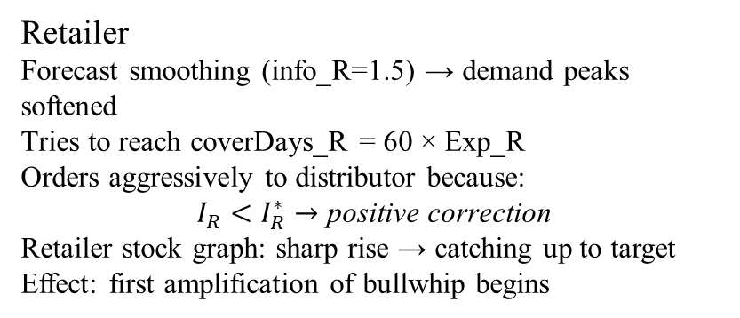
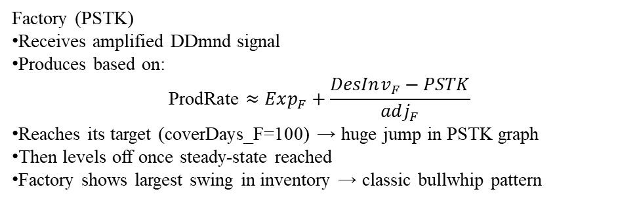
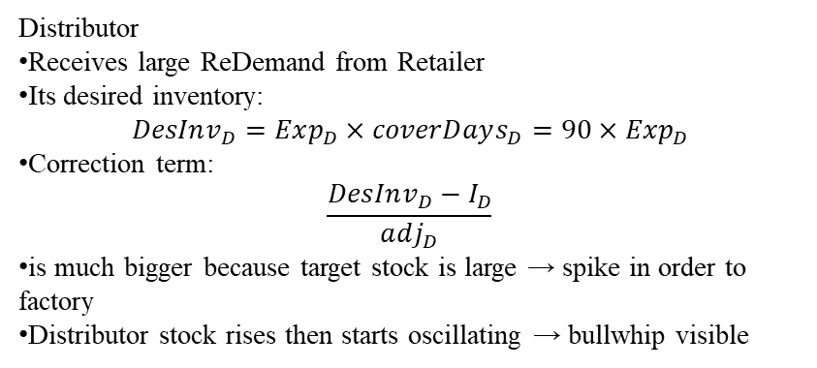
60 days window→ Initial demand shock travels upstream
Retailer
Forecast smoothing (info_R=1.5) → demand peaks softened
Tries to reach coverDays_R = 60 × Exp_R
Orders aggressively to distributor because:
$$I_{R}<I_{R}^{∗}→\text{positive} \text{correction}$$
Retailer stock graph: sharp rise → catching up to target
Effect: first amplification of bullwhip begins
Distributor
Receives large ReDemand from Retailer
Its desired inventory:
$$DesInv_{D}=Exp_{D}×coverDays_{D}=90×Exp_{D}$$
Correction term:
$$\frac{DesInv_{D}−I_{D}}{adj_{D}}$$
is much bigger because target stock is large → spike in order to factory
Distributor stock rises then starts oscillating → bullwhip visible
Factory (PSTK)
Receives amplified DDmnd signal
Produces based on:
$$\text{ProdRate}≈Exp_{F}+\frac{DesInv_{F}−PSTK}{adj_{F}}$$
Reaches its target (coverDays_F=100) → huge jump in PSTK graph
Then levels off once steady-state reached
Factory shows largest swing in inventory → classic bullwhip pattern

Slide 22
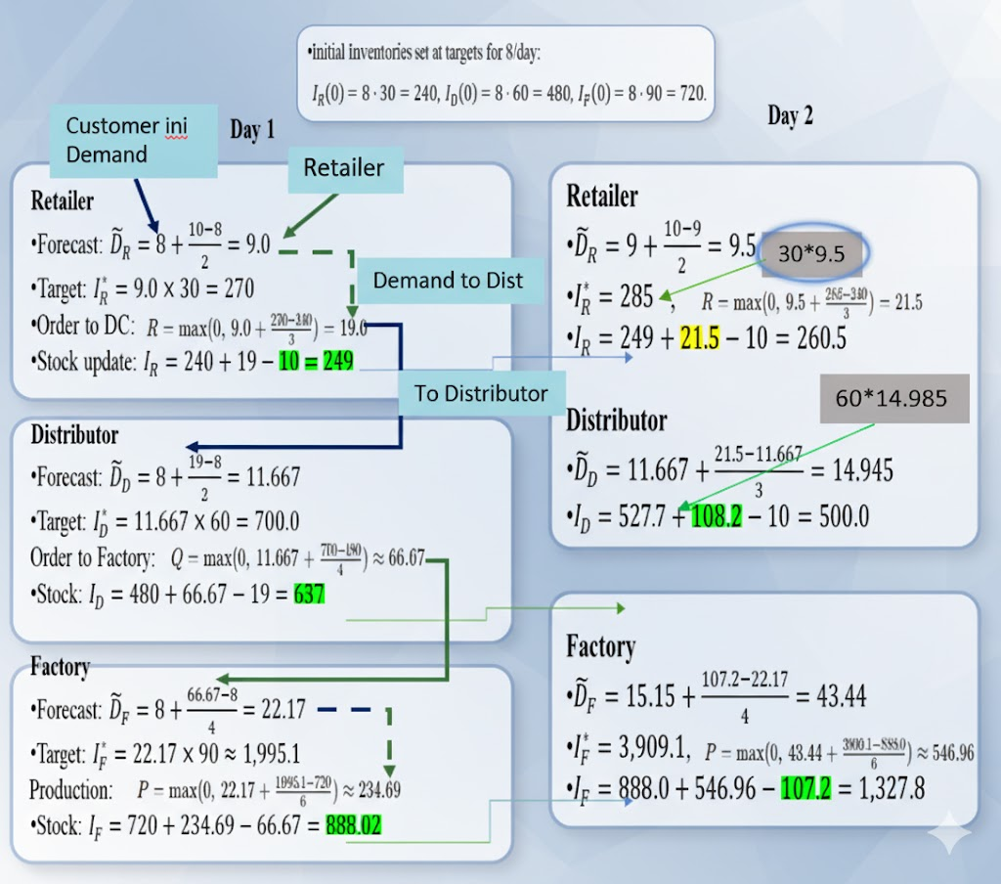
Working Principle of the Designed SD Model
Customer ini Demand
Forecasted Demand
30*9.5
Demand to Dist
To Distributor
60*14.945
$I_{R}\left(t\right), I_{D}\left(t\right), I_{F}\left(t\right)$ = retailer, distributor, factory inventory.

Slide 23
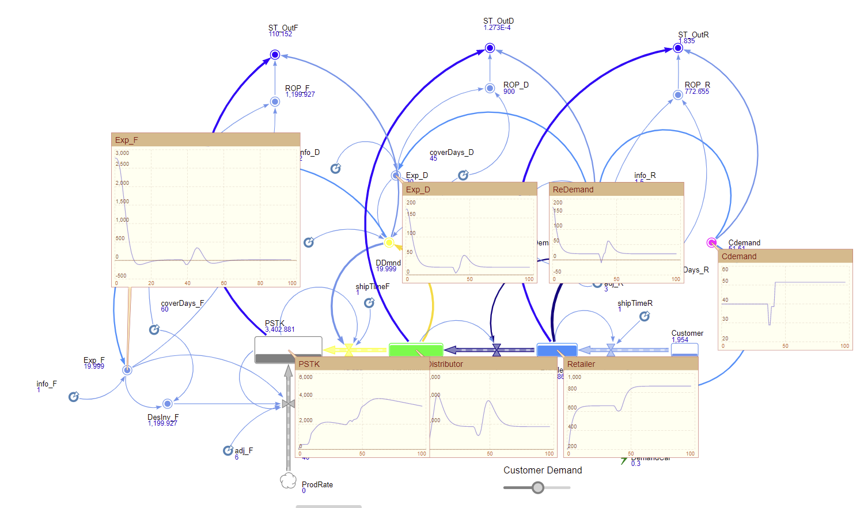
Working Principle of the Designed SD Model

Slide 24
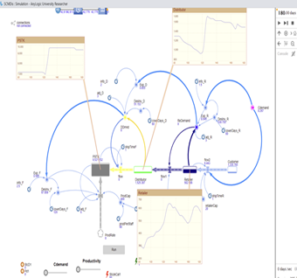
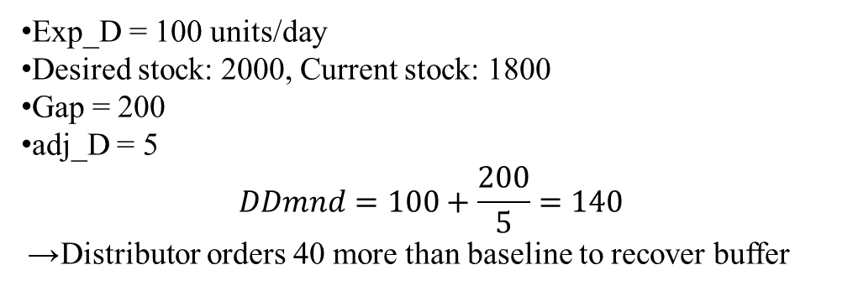
Working Principle of the Designed SD Model
Exp_D = 100 units/day
Desired stock: 2000, Current stock: 1800
Gap = 200
adj_D = 5
$$DDmnd=100+\frac{200}{5}=140$$
→ Distributor orders 40 more than baseline to recover buffer

Slide 25
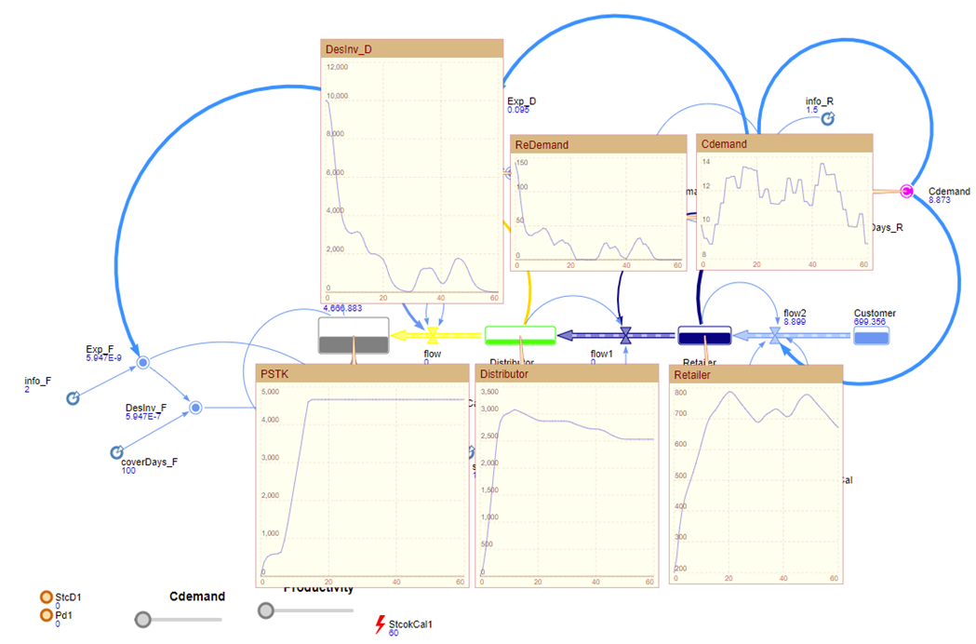
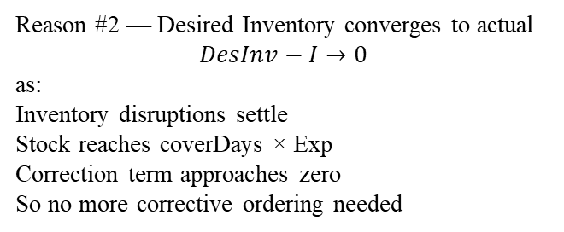
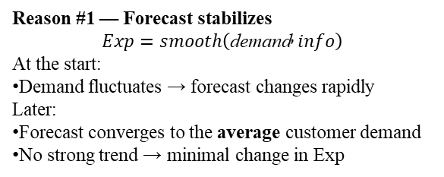
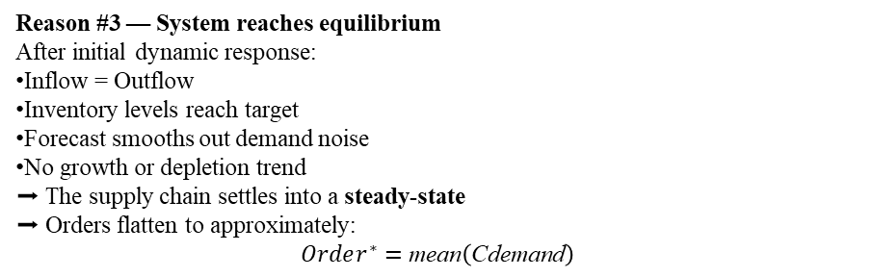
Why Demand (Orders) Flatten Over Time
Reason #1 — Forecast stabilizes
$$Exp=smooth\left(\text{demand} , info\right)$$
At the start:
Demand fluctuates → forecast changes rapidly
Later:
Forecast converges to the average customer demand
No strong trend → minimal change in Exp
Reason #2 — Desired Inventory converges to actual
$$DesInv−I→0$$
as:
Inventory disruptions settle Stock reaches coverDays × Exp Correction term approaches zero
So no more corrective ordering needed
Reason #3 — System reaches equilibrium
After initial dynamic response:
Inflow = Outflow
Inventory levels reach target
Forecast smooths out demand noise
No growth or depletion trend
➡ The supply chain settles into a steady-state ➡ Orders flatten to approximately:
$$Order^{∗}=\text{mean}\left(\text{Cdemand}\right)$$

Slide 26

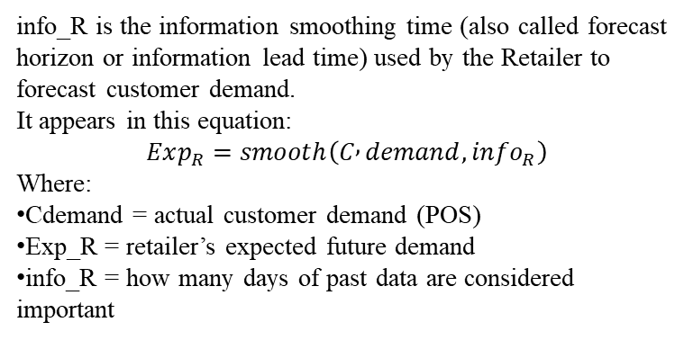
Demand vs Stock flow
info_R is the information smoothing time (also called forecast horizon or information lead time) used by the Retailer to forecast customer demand.
It appears in this equation:
$$Exp_{R}=smooth\left(C , demand,info_{R}\right)$$
Where:
Cdemand = actual customer demand (POS)
Exp_R = retailer’s expected future demand
info_R = how many days of past data are considered important
Information smoothing is necessary to reduce noise, but it introduces a delay that contributes to bullwhip amplification.

Slide 27
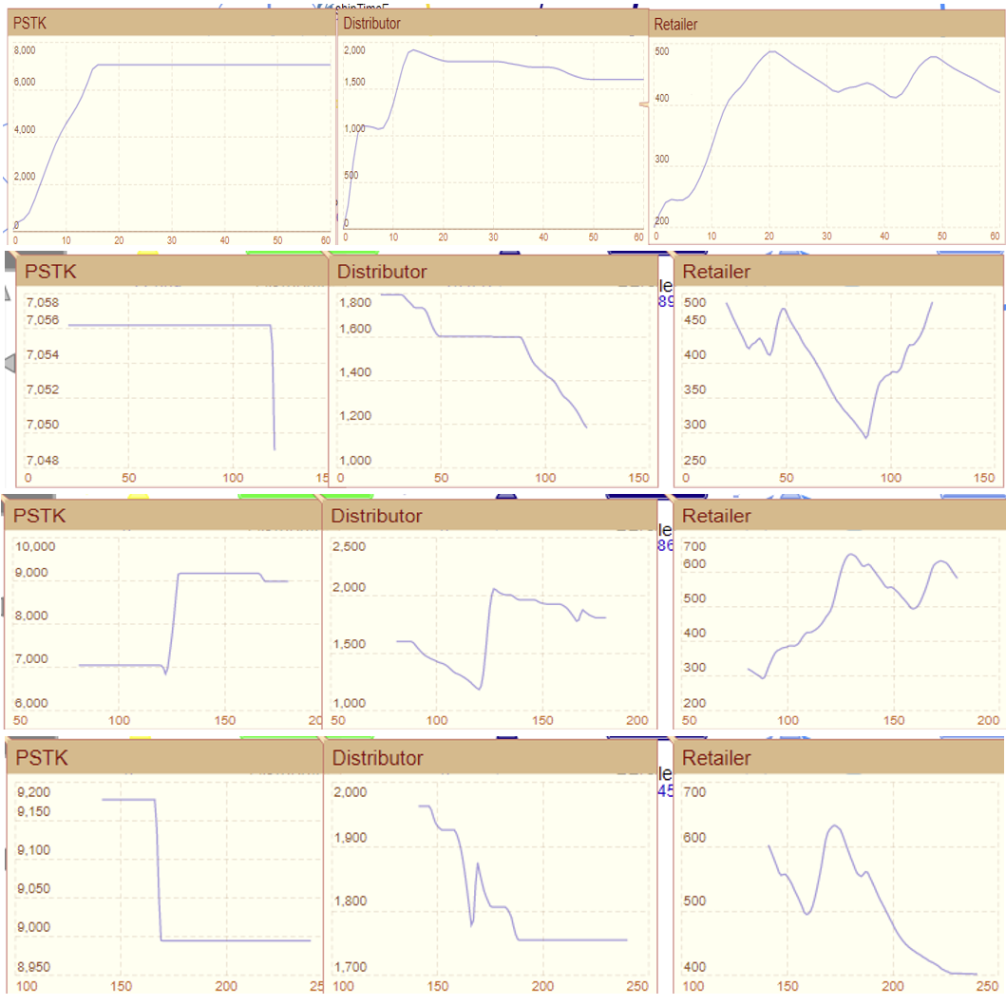
Stock presentation in 60 days interval for SCM Domain
Figure: Stock presentation for 3 domain (Small change becomes big waves upstream

Slide 28
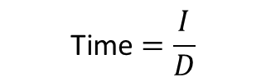
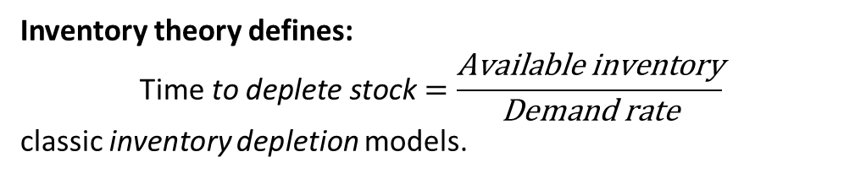
Scenario Analysis for Demand Variation
Inventory depletion under constant demand.
Inventory theory defines:
$$\text{Time} \text{to} \text{deplete} \text{stock}=\frac{\text{Available} \text{inventory}}{\text{Demand} \text{rate}}$$
classic inventory depletion models.
$$\text{Time}=\frac{I}{D}$$
ROP= Expected Demand * Expected cover Days;
Or Externally any specific Number
Stock Days= (Stock-ROP ) / demand ) ); ROP means Reorder Points
Stock-ROP = how many extra units below the Reorder point.
If Stock is less & ROP more, that means negative qty will be there which is called stockout qty
Stock =600, ROP= 700,Demand =50
Stcokout days = (-100)/50= 2 days
Our stockout-time equation follows directly from classical inventory-depletion theory (Hadley & Whitin, 1963) combined with reorder-point logic (Axsäter, 2015).”

Slide 29
Fixed ROP vs Dynamic ROP
Currently ROP & Desired Inventory Level is same. But we can define our ROP explicitly also. we also can vary demand fluctuation.
Since we are working for how many days we need to stock as safety, so safety stock is days to cover the stock.
ROP= demand× (LT+SS).
CoverDays_R acts as (Lead time + safety stock days)
Why this is better than a fixed ROP
It reacts automatically to demand trends.
It avoids understocking during demand growth.
It avoids excess stock when demand falls.
It reflects real-world policy in continuous-time form.

Slide 30
Distributor Demand Variation -14 Days Run
More Demand means Negative stock continued for more days

Slide 31
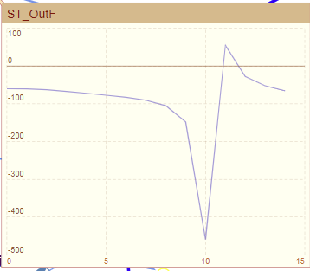
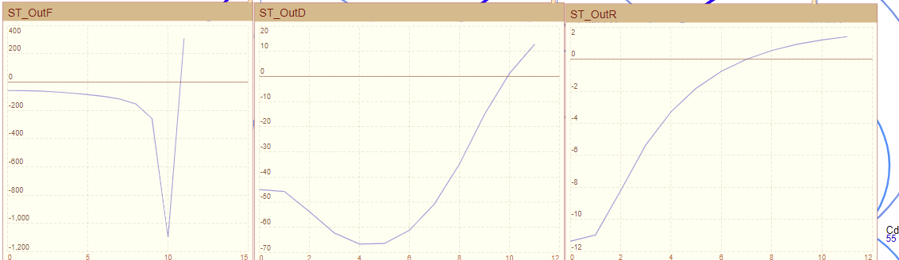
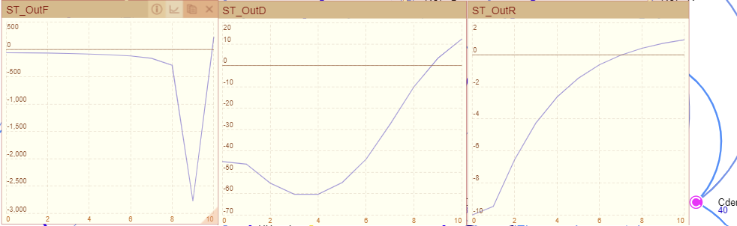
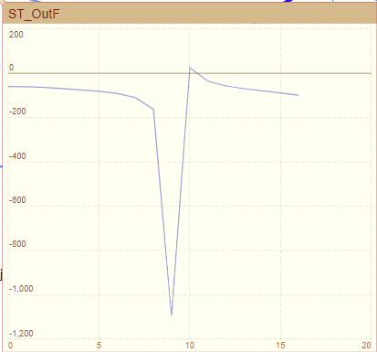
Stockout Days analysis based on Demand variation
Stock out for 12 days
Stock out for 10 days
Stock out for 6.9 days
Lower Limit
-12 unit
Qty
Days
Demand 55 units
Stock out for 10 days
Stock out for 8.5 days
Stock out for 6.7 days
Lower Limit
-10 unit
Demand 40 units

Slide 32
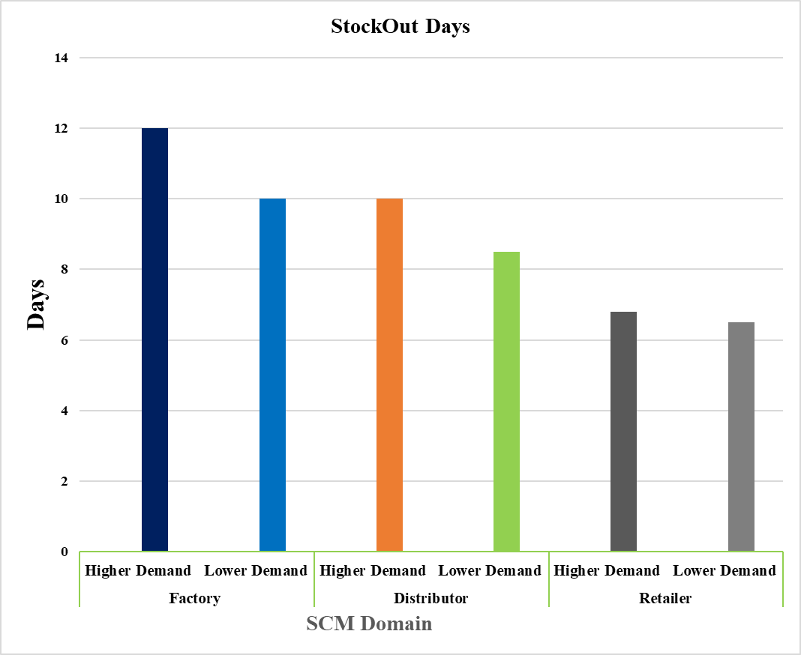
Stockout analysis based on Demand variation
Table: Stockout Days analysis based on Demand variation
Echelon | Scenario | Demand Level | Stockout Time (days)
Factory | Higher Demand | 55 | 12
 | Lower Demand | 40 | 10
Distributor | Higher Demand | 55 | 10
 | Lower Demand | 40 | 8.5
Retailer | Higher Demand | 55 | 6.8
 | Lower Demand | 40 | 6.5
Figure: Stockout Days vs Demand

Slide 33
Observation
The stockout-time curves represent how many days each echelon can continue fulfilling orders before reaching its reorder-point safety threshold.
When customer demand increases, the effective demand signals (Cdemand, ReDemand, DDmnd) rise across the chain.
The retailer drops fastest because it faces raw customer demand and maintains the smallest inventories, while the distributor shows a slower decline due to smoother ReDemand and larger stocks.
The factory shows the longest stockout time because it holds the largest buffers and sees the most delayed demand signal.
As demand continues to rise, all stockout-time values converge toward zero, indicating imminent stockouts. Thus, the curves validate the expected inverse relationship between demand level and stock-availability duration.”

Slide 34
Conclusion
This study developed a comprehensive System Dynamics framework to analyze inventory behavior and demand-signal distortion across a multi-echelon supply chain.
By integrating forecasting delays, inventory-adjustment mechanisms, and replenishment responses, the model captures the dynamic interactions that give rise to the bullwhip effect an enduring challenge in supply chain management.
The formulation of order-up-to logic, safety-stock targets, and stockout-time estimation enabled a realistic representation of how demand fluctuations propagate from retailers upstream to distributors and factories.
The framework also illustrates the nonlinear feedback loops that drive amplification effects, thereby emphasizing the importance of coordinated decision-making and rational parameterization of forecasting and adjustment delays.
Overall, the proposed model serves as a decision-support tool for understanding supply-chain instability and experimenting with alternative control strategies. The structure allows for scenario analysis involving demand shifts, service-level constraints, and stock-out risk, laying the groundwork for data-driven inventory optimization in real-world multi-echelon systems.

Slide 35
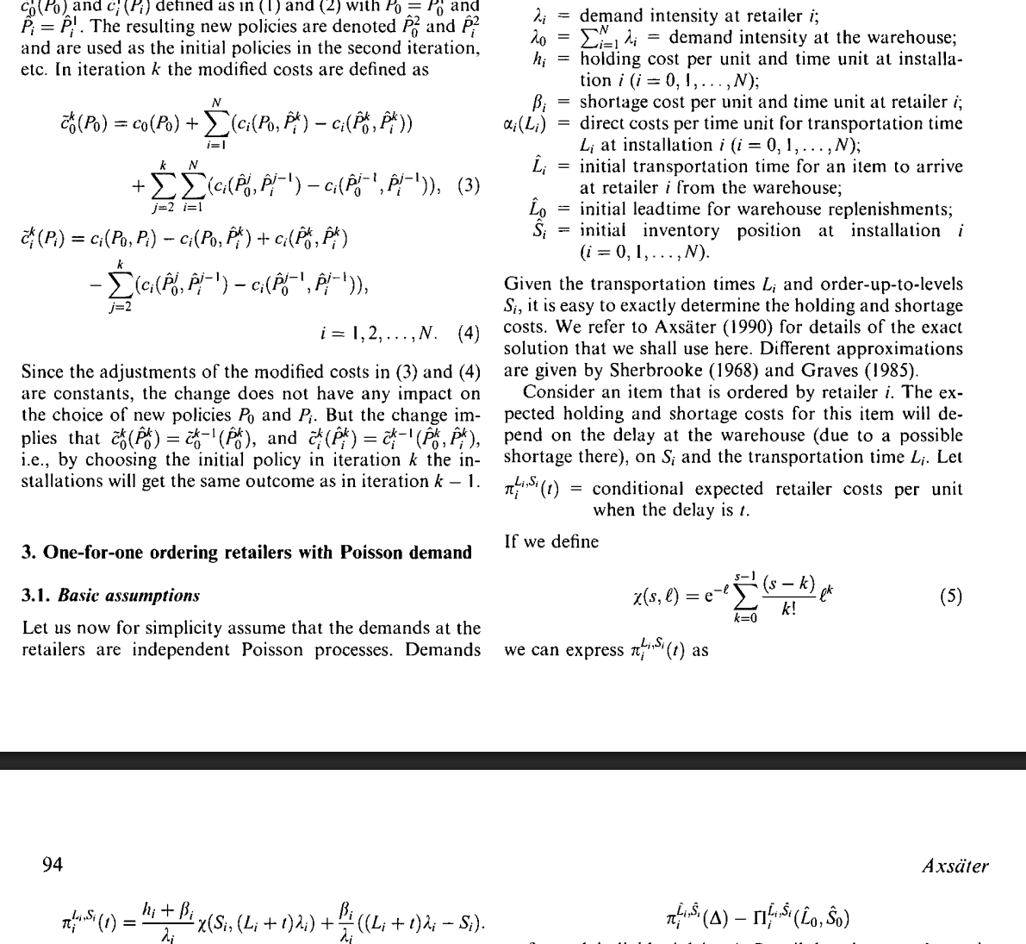
Future work
Axsäter, S. (2001). A framework for decentralized multi-echelon inventory control. Iie Transactions, 33(2), 91-97.

Slide 36
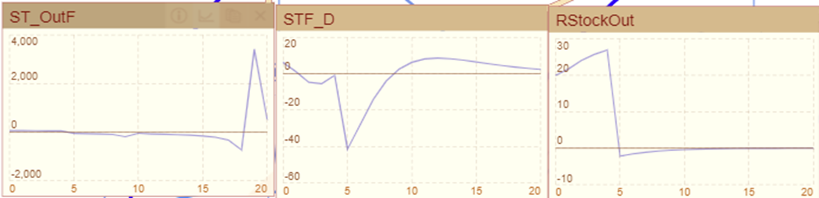
Stock Analysis Based on Varying Demand

Slide 37
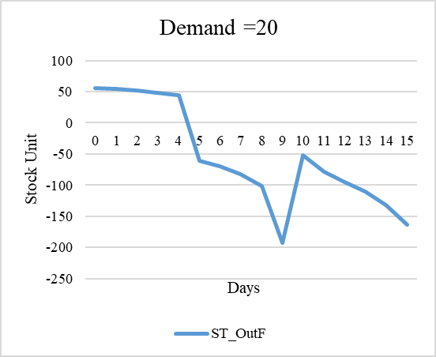
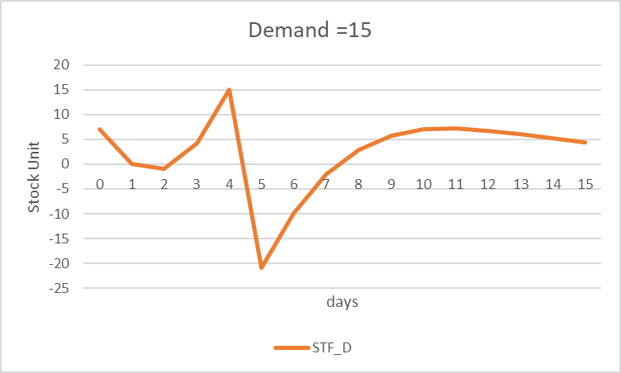
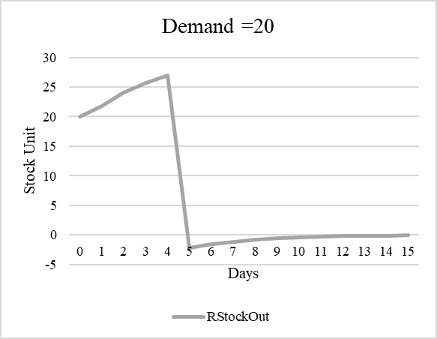
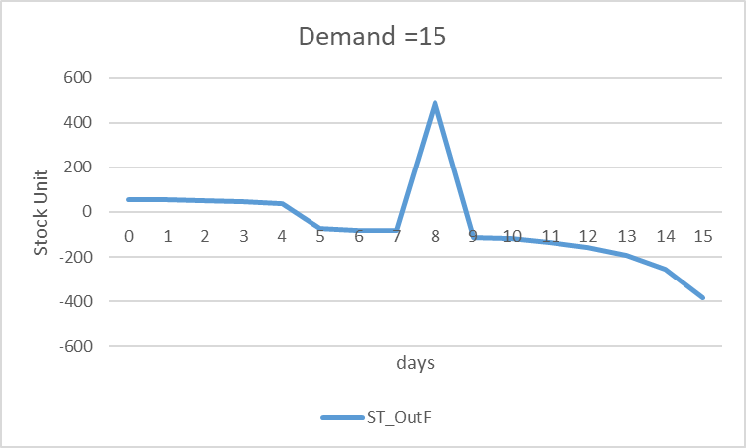
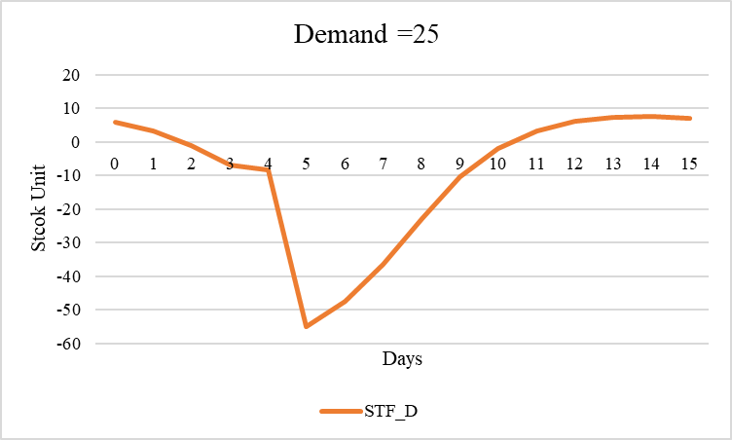
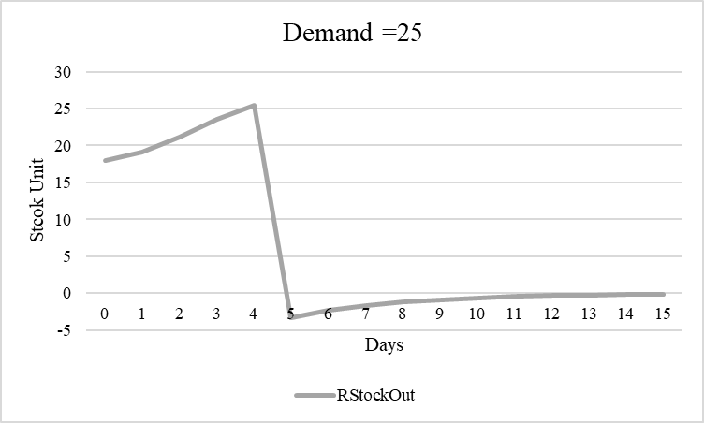
Factory
Distributor
Retailer

Slide 38
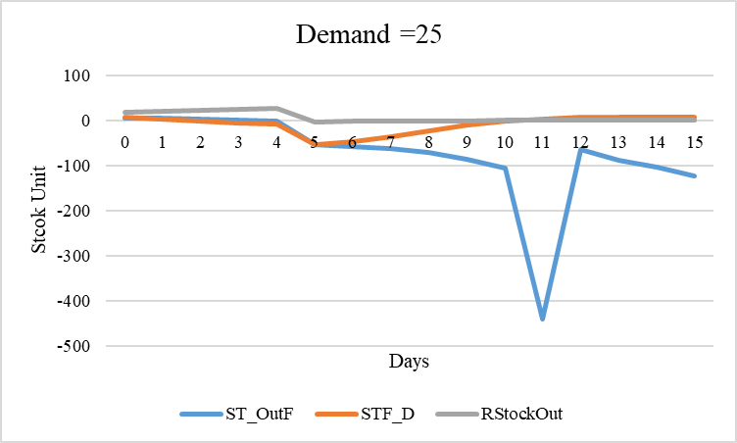
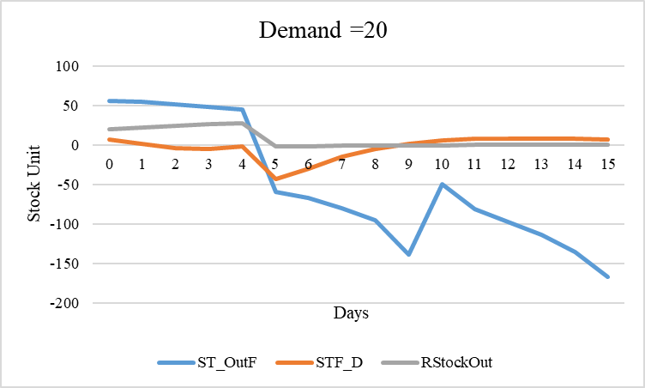
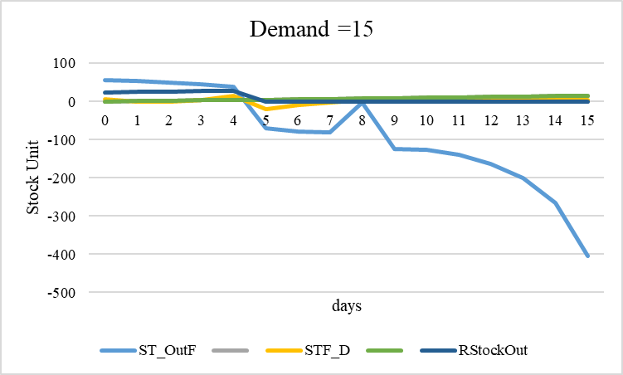
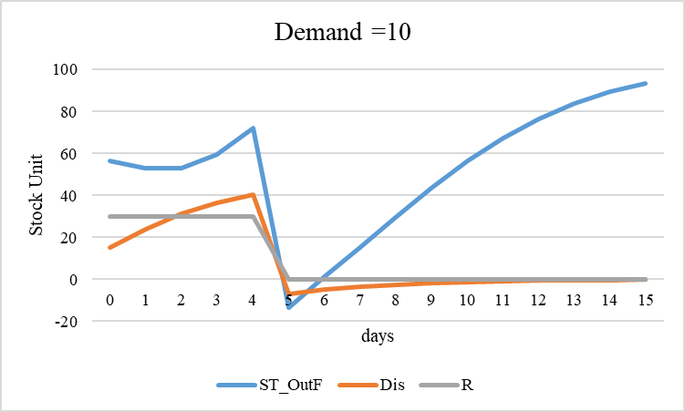
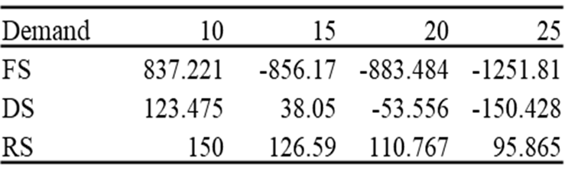
Stock Analysis Based on Varying Demand

Slide 39
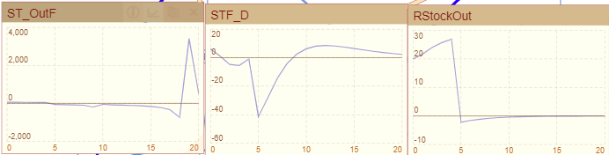
D=20

Slide 40
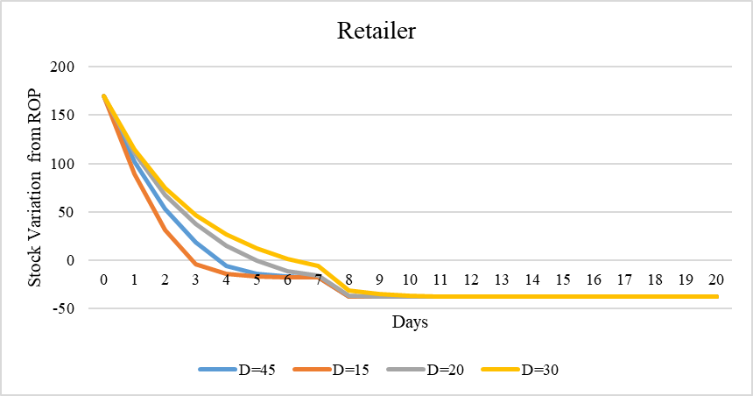
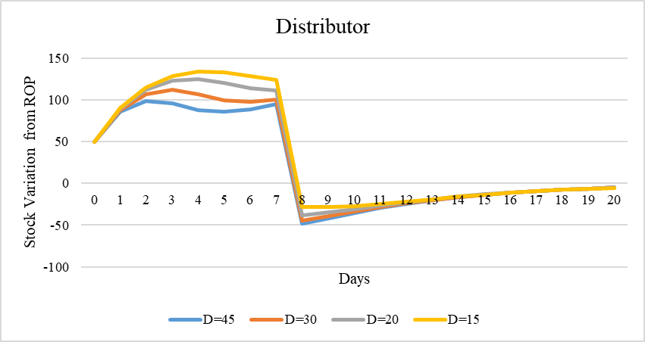
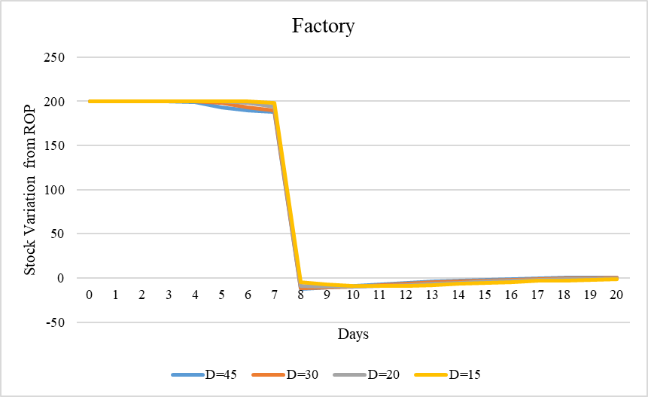
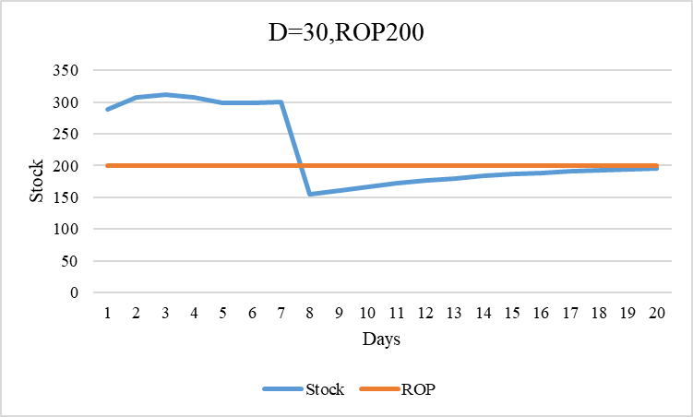

Slide 41


Slide 42



Slide 43


Slide 44


Slide 45

Curve below & Above the ROP for each stage

Slide 46


Slide 47


Slide 48



Demand=50
Demand=40
Demand=10

Slide 49

Inventory Scheme

Slide 50


Slide 51


Slide 52

Order Placing
4 days
2 days
Order Replenishment by maintaining Buffer for varying Customer Demand

Slide 53



Curve below & Above the ROP for each stage by maintaining Buffer

Slide 55
NEXT WEEK PLAN
What is your plan for the coming week?
Remember this is a short-term plan and your small step will help you get a big step.

Slide 56
SUMMARY OF REVIEW PAPER
Any thoughts or criticism about this paper

Slide 57
SUMMARY OF REVIEW PAPER
Did you find anything from this paper that could help in your research?

Slide 58
NEED FOR RESEARCH/ACADEMIC PROGRESS
Discuss what you need for your research and academic progress.
Any resources/materials/equipment/or any other things you feel may be necessary for you.

Slide 59
THANK YOU
Question and Discussion

